Slide 1

Networking in Python

Slide 2
Sockets & IP Addresses
A socket is a network connection endpoint. When your Web browser requests the main Web page of www.python.org, for example, your Web browser creates a socket and instructs it to connect to the Web server hosting the Python Web site, where the Web server is also listening on a socket for incoming requests.
The two sides use the sockets to send messages and other data back and forth.

Slide 3
Ports
each socket is bound to a particular IP address and port.
An IP address is a sequence of four numbers in the range of 0 to 255 (for example, 173.15.20.201); port numbers range from 0 to 65535. Port numbers less than 1024 are reserved for well-known networking services
the maximum reserved value is stored in the socket module’s IPPORT_RESERVED variable.
You can use other port numbers for your own programs, although technically, ports 1024 to 5000 (socket.IPPORT_USERRESERVED) are used for officially registered applications

Slide 4
Localhost Address
The address 127.0.0.1 is the localhost address; it always refers to the current computer. Programs can use this address to connect to other programs running on the same machine.
.Domain Name Servers (DNS) handle the task of mapping the names to the IP addresses. Every computer can have a host name, even if it isn’t an officially registered one.
HTTP is the protocol used to communicate between Web browsers and Web servers, and it is built upon the TCP protocol, which is in turn built upon a protocol named IP.

Slide 5
TCP & UDP
TCP and UDP protocols.
TCP creates a persistent connection between two endpoints, and the messages that you send are guaranteed to arrive at their destination and to arrive in order.
UDP is connectionless, a bit faster, but less reliable. Messages you send may or may not make it to the other end; and if they do make it, they might arrive out of order

Slide 6
The socket module
The socket module provides several functions for working with host names and addresses.
The socket module is a very close wrapper around the C socket library; and like the C version, it supports all sorts of options.
gethostbyname(name) tries to resolve the given host name to an IP address.
An extended form, gethostbyname_ex(name), returns a 3-tuple consisting of the primary host name of the given address, a list of alternative host names for the same IP address,
The gethostbyaddr(address) function does the same thing, except that you supply it an IP address string instead of a host name:

Slide 7
getservbyname(service, protocol) takes a service name (such as ‘telnet’ or ‘ftp’) and a protocol (such as ‘tcp’ or ‘udp’) and returns the port number used by that service:
non-Python programs store and use IP addresses in their 32-bit packed form. The inet_aton(ip_addr) and inet_ntoa(packed) functions convert back and forth between this form and an IP address string
socket also defines a few variables representing some reserved IP addresses.
INADDR_ANY and INADDR_BROADCAST are reserved IP addresses referring to any IP address and the broadcast address, respectively; and INADDR_LOOPBACK refers to the loopback device, always at address 127.0.0.1. These variables are in the numeric 32-bit form.

Slide 8
Connecting Sockets
When two sockets connect (via TCP, for example), one side listens for and accepts an incoming connection, and the other side initiates that connection.
The listening side creates a socket, calls bind(address) to bind it to a particular address and port, calls listen(backlog) to listen for incoming connections, and finally calls accept() to accept the new, incoming connection

Slide 9
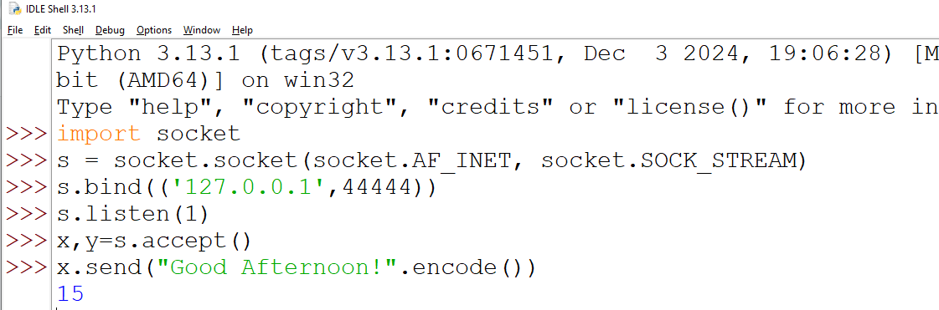
Server

Slide 10
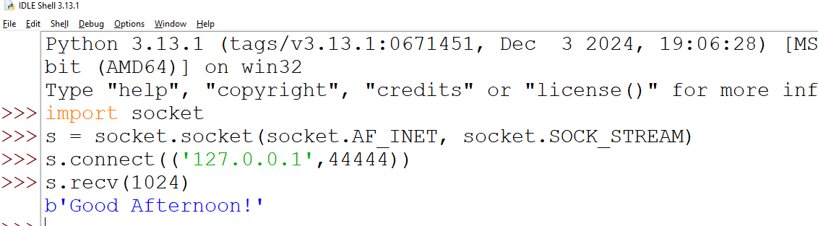
Client

Slide 11
Program Explanation
The addresses you pass to bind and connect are 2-tuples of (ipAddress,port) for AF_INET sockets.
If the underlying call to the C connect returns an error, connect_ex will also return an error (or 0 for success), instead of raising an exception.
When you call listen, you pass in a number specifying the maximum number of incoming connections that will be placed in a wait queue.
If more connections arrive when the queue is full, the remote side is informed that the connection was refused.
The SOMAXCONN variable in the socket module indicates the maximum size the wait queue can be.
The accept() method returns an address of the same form used by bind and connect, indicating the address of the remote socket.

Slide 12
Sending & Receiving Data
send(string[, flags]) sends the given string of bytes to the remote socket. sendto(string[, flags], address) sends the given string to a particular address.
Both send and sendto return the number of bytes that were actually sent. When sending large amounts of data quickly, you may want to ensure that the entire message was sent

Slide 13
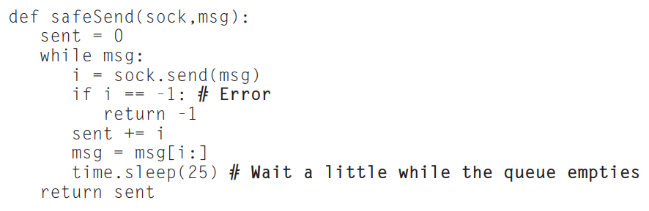
Socket Program

Slide 14
Using Socket Options
A socket object’s getpeername() and getsockname() methods both return a 2- tuple containing an IP address and a port
getpeername returns the address and port of the remote socket to which it is connected, and getsockname returns the same information for the local socket
sockets are blocking, which means that socket method calls don’t return until the action completes
the call to send will try to block until it can put more data into the buffer. You can change this behavior by calling the setblocking(flag) method with a value of 0
When a socket is nonblocking, it will raise the error exception if the requested action would cause it to block

Slide 15
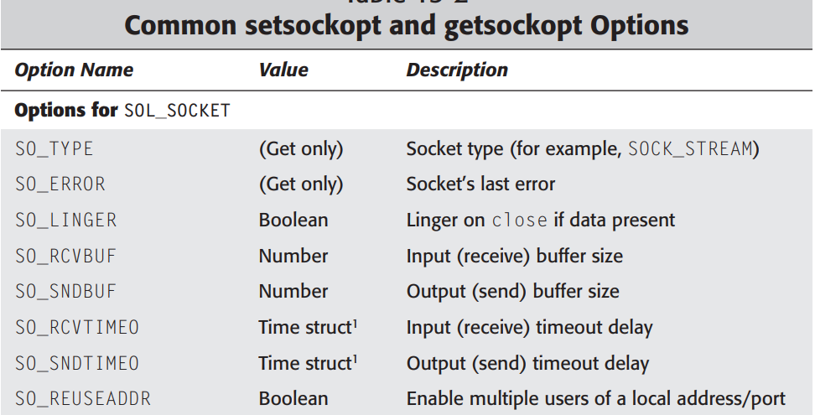

Slide 16
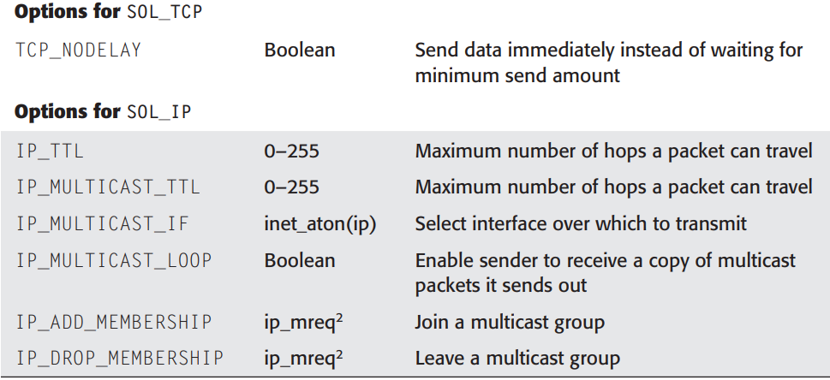

Slide 17
The End

